Slide 1


Automatic Timetable Generation using Genetic Algorithm
Logo here
Group 13
Dr.Phiroj Shaikh
1-11-2019

Slide 2
Group Members
Olivia D’sa-18
Denzil D’souza-21
Prayuj Pillai-46

Slide 3
Introduction
Even though most college administrative work has been computerized, the lecture timetable scheduling is still mostly done manually due to its inherent difficulties.
The manual lecture-timetable scheduling demands considerable time and efforts.
The lecture-timetable scheduling is a Constraint satisfaction problem in which we find a solution that satisfies the given set of constraints.
It is an NP hard problem.

Slide 4
Background of the Project
Many Colleges uses Timetable software for scheduling lectures, practical, tutorial and academic activities.
This software is proprietary and not open source, a fee has to be paid for using this software legally.
Due to this fact, an open source “Automatic Timetable Generation” software is the better way to go.

Slide 5
Motivation
Many colleges use manual way of preparing timetables with large number of students is very time consuming.
This usually ends up with various courses clashing this may be either at same room or with same teachers having more than one course at a time.
These are just due to common human errors which are very difficult to prevent in the processes.
To overcome all these problems we propose this automatic timetable generation system.
This system will take various inputs like details of students, subjects and classrooms and teachers available, depending upon these input it will generate possible timetable, making the utilization of all of these resources in a way that will best suit any of constrains of college rules.

Slide 6
Objectives
To generate an optimized timetable.
To use genetic algorithm to generate the timetable
To satisfy all the hard constraints.
To satisfy soft constraints as much as possible.
Final timetable is the timetable with the best fitness.

Slide 7
Problem Statement
The timetable generator aims to create the best optimised timetable for any given institution.
To consider various constraints while generating a timetable.
Apply the genetic algorithm approach to produce the best optimal timetable based on the organizations preferences and specified constraints.

Slide 8
Scope of the project
Project Goals:
Make a comprehensive “Automatic Timetable Generation” Software that Schedules lectures, labs, etc. efficiently.
Make use of Genetic Algorithm for its implementation.
Software handles all the relevant constraints.
Project Deliverables:
Timetable generated automatically using Genetic Algorithm.
Exporting Timetable for each course, class-room, lecture and class into suitable formats.

Slide 9
Requirements of the project
Following information will be required from the particular organization:
Class (Name, Semester, Department,)
Lecturer (Name, Array of Subjects Taught by the Teacher, Rank of the Teacher (e.g. HOD), Department)
Course (Name, Class, Department, Type, Hours per week, Max Hours, Min Hours, Lecture Type)
Classrooms (Name, Array of Students, Capacity)
Hours
Days

Slide 10
Technology Used
Front End-React JS
Back End-PHP,MYSQL
Logical Implementation-J2EE technologies/Spring Framework
Logic Building - Python

Slide 11
Literature Survey
Sr No. | Paper Title | Authors | Summary | Conclusions
1 | Solving Timetable Problem by Genetic Algorithm and Heuristic Search Case Study: Universitas Pelita Harapan Timetable | Samuel Lukas, Arnold Aribowo and Milyandreana Muchri | Steps involved in GA are thoroughly explained in this paper. The operations performed in each step that is Selection, Crossover and Mutation are given in detail. Input format is presented well in the paper. The target matrix is the data stricture used for input. | Soft Constraints are not included in the scope along with constraints of classrooms.
2 | Electronic Lecture Time-table Scheduler using Genetic Algorithm | Jumoke Soyemi, John Akinode and Samson Oloruntoba | Compares MTTS with GA, and shows flowchart of how GA is implemented | Preference of the University to use Automatic Scheduling with GA. However Soft constraints are not taken care of.

Slide 12
3 | Solving Timetable Scheduling Problem Using Genetic Algorithms | Branimir Sigl, Marin Golub and Vedran Mornar | Shows formation of Chromosomes and Genes which are used as the basis for GA | Alternate approach to the data structure being used to optimised.
4 | Solving Timetabling Problem Using Genetic and Heuristic Algorithms | Nguyen Duc Thanh | Incorporates the use of a hybrid algorithm consisting of Genetic and Heuristic Algorithm. Using this Algorithm Timetabling problem is converted into a way of optimally solving a 2D Matrix. | Crossover and Mutation operations of the given system will be used.
5 | Genetic Algorithms vs. Simulated Annealing: A Comparison of Approaches for Solving the Circuit Partitioning Problem | Theodore W. Manikas and James T. Cain | A simplified model of the placement problem circuit partitioning was tested on three circuits with both a genetic algorithm and a simulated annealing algorithm When compared with simulated annealing the genetic algorithm was found to produce similar results for one circuit and better results for the other two circuits | The study concluded its findings based on a very small dataset rather than considering a large data set to give an approximate percentage as on how much is genetic algorithm more efficient than simulated annealing

Slide 13

Alternate Approach

Slide 14
Comparison between Genetic Algorithm and Heuristic Search.
Genetic Algorithm | Heuristic Search
Genetic Algorithm are typically applied to problems that require only the location of a vertex that satisfies the search. | Heuristic search often require the construction of a path through the graph.
Genetic Algorithm is often applied to problems that do not specify how an acceptable solution can be recognized. | Heuristic Search is often applied to problems that do specify how an acceptable solution can be recognized.
Genetic Algorithm navigates on several graphs. | State space search algorithm tends to navigate on a single graph.

Slide 15
Comparison of Genetic Algorithm with Hill Climbing and Simulating Annealing
Parameter | Genetic Algorithm | Hill Climbing | Simulated Annealing
Functionality | Belong to a family of computational models inspired by evolution. | Belongs to the family of local search. | It is a mathematical and modelling method that is often used to help find a global optimization in a particular function or problem.
Performance | Faster compared to other algorithms | Slower as compared to GA. | Slower as compared to GA.
Representation | Bit-String representation is critical. | Move Set design is critical | Move Set design is critical.
Multi-dimensional | Supports | Does not support | Does not support
Technique preferred | Global Optimum | Local Optimum | Global Optimum

Slide 16
Why Use Genetic Algorithm?
Gives appropriate solution to search problems when the search space is complex and large.
They are Robust.
Succeeds in getting the best optimal solution as opposed to other common optimization algorithms.
Unlike traditional AI, they do not break on slight change in input or presence of noise
Can explore solution space multiple directions at once.
Fast compared to the other traditional Algorithms.
The main difference between genetic algorithm and traditional algorithm is that genetic algorithm is a type of algorithm that is based on the principle of genetics and natural selection to solve optimization problems while traditional algorithm is a step by step procedure to follow, in order to solve a given problem

Slide 17
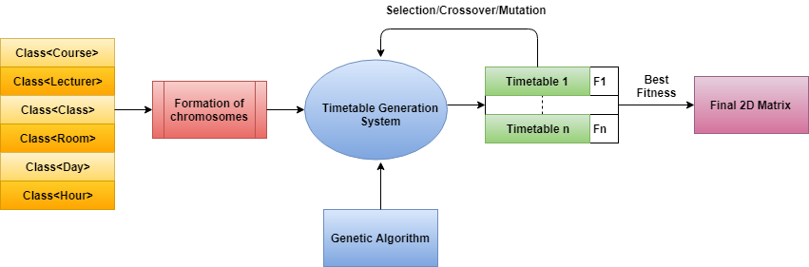
Proposed Design (System Architecture)

Slide 18
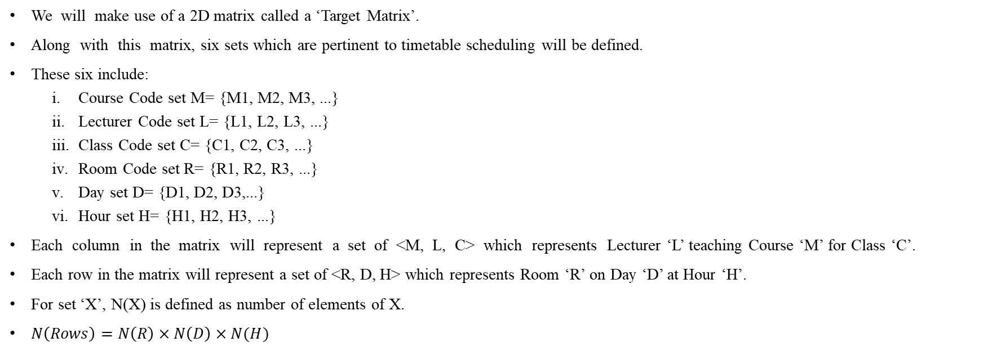
Framework of Proposed System
We will make use of a 2D matrix called a ‘Target Matrix’.
Along with this matrix, six sets which are pertinent to timetable scheduling will be defined.
These six include:
Course Code set M= {M1, M2, M3, ...}
Lecturer Code set L= {L1, L2, L3, ...}
Class Code set C= {C1, C2, C3, ...}
Room Code set R= {R1, R2, R3, ...}
Day set D= {D1, D2, D3,...}
Hour set H= {H1, H2, H3, ...}
Each column in the matrix will represent a set of <M, L, C> which represents Lecturer ‘L’ teaching Course ‘M’ for Class ‘C’.
Each row in the matrix will represent a set of <R, D, H> which represents Room ‘R’ on Day ‘D’ at Hour ‘H’.
For set ‘X’, N(X) is defined as number of elements of X.
$N\left(Rows\right)=N\left(R\right)×N\left(D\right)×N(H)$

Slide 19

Framework of Proposed System
 | m1, l1, c1 | m1, l2, c1 | m2, l1, c2 | …
r1, d1, h1 | 1 | -1 | -1 | …
r1, d1, h2 | 1 | -1 | -1 | …
r1, d2, h1 | -1 | 1 | -1 | …
r1, d2, h2 | -1 | 1 | -1 | …
r2, d1, h1 | 1 | -1 | -1 | …
r2, d1, h2 | 1 | -1 | -1 | …
r2, d2, h1 | 0 | 0 | 0 | …
r2, d2, h2 | -1 | -1 | 1 | …
… | … | … | … | …
No. of units Scheduled (th) | 4 | 2 | 1
Target Matrix

Slide 20
Framework of Proposed System
From the target matrix for an element M_{ij}, if it is set to 1, it indicates that Lecturer ‘L’ teaching Course ‘M’ for Class ‘C’ is scheduled to Room ‘R’ on Day ‘D’ at Hour ‘H’.
Each Cell value can have the following values
M_{ij} = 0, indicates that the slot is available to be scheduled
M_{ij} = 1, indicates that the slot has been scheduled
M_{ij} = -1, indicates that the slot cannot be scheduled
Also, for each element M_{ij} a set of 6 functions are defined namely f_{m}, f_{l}, f_{c}, f_{r}, f_{d} and f_{h} which return information of attributes course, lecturer, class, room, day and hour respectively.

Slide 21
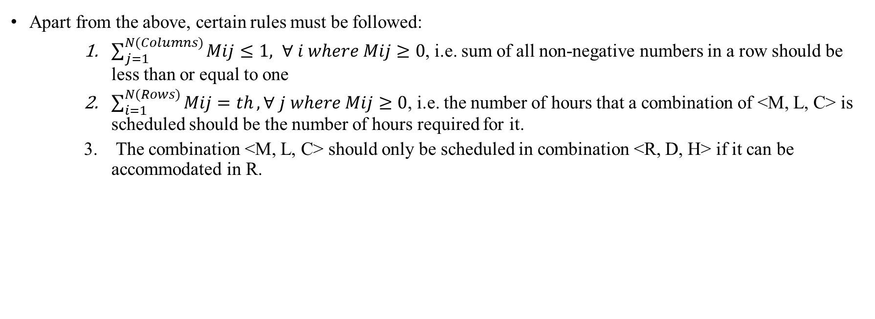
Framework of Proposed System
Apart from the above, certain rules must be followed:
$\sum_{j=1}^{N(Columns)}{Mij≤1, ∀ i where Mij≥0}$, i.e. sum of all non-negative numbers in a row should be less than or equal to one
$\sum_{i=1}^{N(Rows)}{Mij=th}, ∀ j where Mij≥0$, i.e. the number of hours that a combination of <M, L, C> is scheduled should be the number of hours required for it.
The combination <M, L, C> should only be scheduled in combination <R, D, H> if it can be accommodated in R.

Slide 22
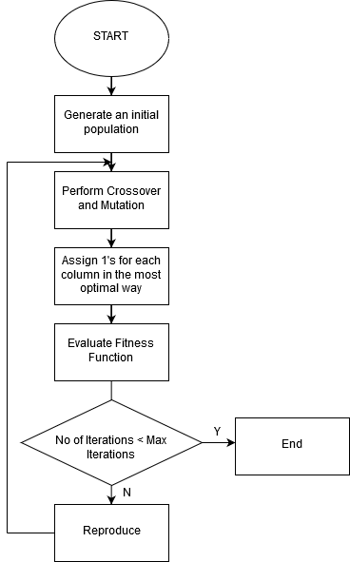
Framework of Proposed System
Proposed Algorithm

Slide 23
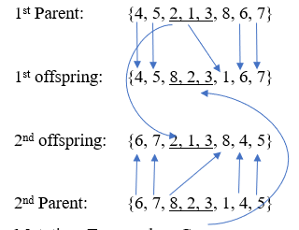
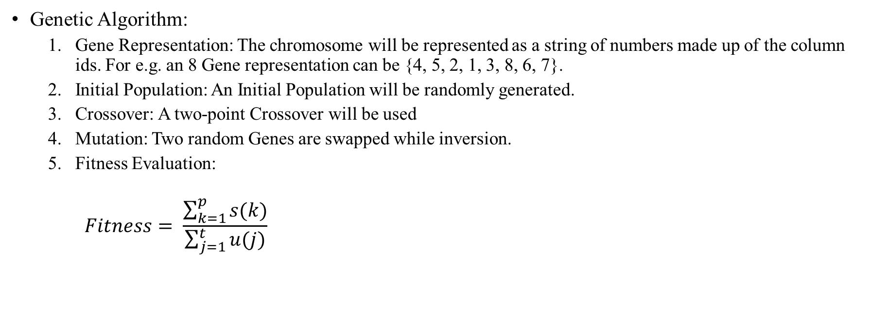
Framework of Proposed System
Genetic Algorithm:
Gene Representation: The chromosome will be represented as a string of numbers made up of the column ids. For e.g. an 8 Gene representation can be {4, 5, 2, 1, 3, 8, 6, 7}.
Initial Population: An Initial Population will be randomly generated.
Crossover: A two-point Crossover will be used
Mutation: Two random Genes are swapped while inversion.
Fitness Evaluation:
$$Fitness= \frac{\sum_{k=1}^{p}{s(k)}}{\sum_{j=1}^{t}{u(j)}}$$

Slide 24
Expected Outcomes
Taking input from the User including hard constraints and soft constraints.
Mapping User Input to appropriate input of the Genetic Algorithm.
Designing Genetic Algorithm to effectively perform selection, crossover, mutation and fitness calculation.
Once desired fitness is achieved, map output of Genetic Algorithm to appropriate User output.
Storing intermediate results in database for later implementation.

Slide 25
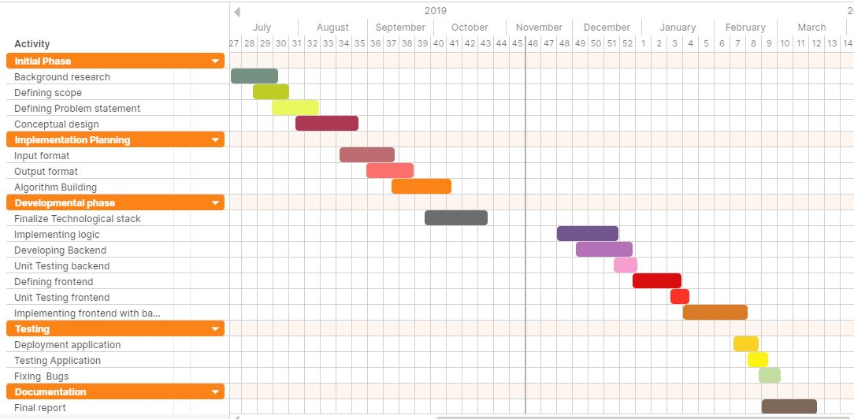
Plan

Slide 26
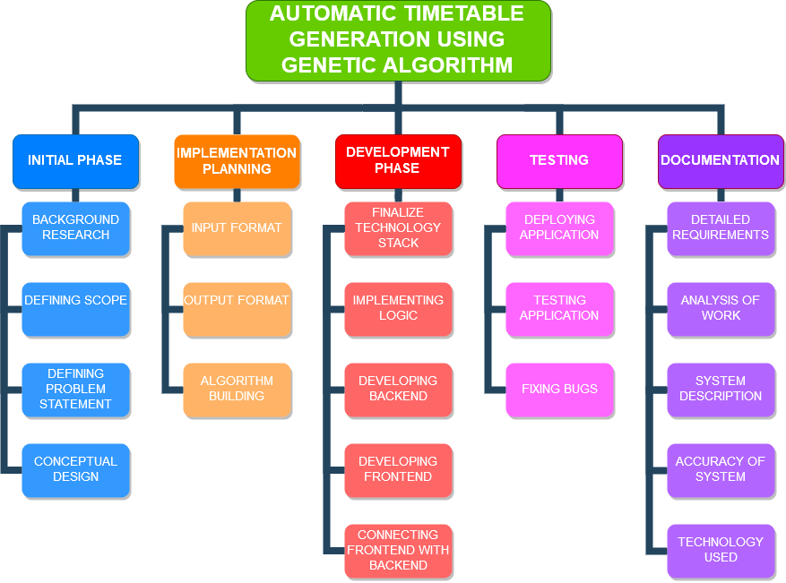
Work breakdown structure

Slide 27

Responsibility Matrix
Initial Phase
Name | Background Research | Defining Scope | Defining Problem Statement | Conceptual Design
Olivia
Denzil
Prayuj
Implementation Planning
Name | Input Format | Output Format | Algorithm Building
Olivia
Denzil
Prayuj

Slide 28
Responsibility Matrix
Development Phase
Name | Finalize Technology Stack | Implementing Logic | Developing Backend | Developing Frontend | Connecting Frontend and Backend
Olivia
Denzil
Prayuj
Testing
Name | Deploying Application | Testing Application | Fixing Bugs
Olivia
Denzil
Prayuj

Slide 29
References
[1] Lukas, Samuel & Aribowo, Arnold & Muchri, Milyandreana. (2012). Solving Timetable Problem by Genetic Algorithm and Heuristic Search Case Study: Universitas Pelita Harapan Timetable.10.1109/ICADIWT.2009.5273979.
[2] Soyemi, Jumoke & John Lekan, Akinode & Oloruntoba, Samson. (2017). Electronic Lecture Time-Table Scheduler Using Genetic Algorithm. 10.1109/DASC-PICom-DataCom-CyberSciTec.2017.124.
[3] B. Sigl, M. Golub and V. Mornar, "Solving timetable scheduling problem using genetic algorithms," Proceedings of the 25th International Conference on Information Technology Interfaces, 2003. ITI 2003., Cavtat, Croatia, 2003, pp. 519-524.
doi: 10.1109/ITI.2003.1225396
[4] N. D. Thanh, "Solving Timetabling Problem Using Genetic and Heuristic Algorithms," Eighth ACIS International Conference on Software Engineering, Artificial Intelligence, Networking, and Parallel/Distributed Computing (SNPD 2007), Qingdao, 2007, pp. 472-477.doi: 10.1109/SNPD.2007.464
URL:http://ieeexplore.ieee.org/stamp/stamp.jsp?tp=&arnumber=4287899&isnumber=4287802
[5] Manikas, Theodore W. and Cain, James T., "Genetic Algorithms vs. Simulated Annealing: A Comparison of Approaches for Solving the Circuit Partitioning Problem" (1996). Computer Science and Engineering Research. 1.
https://scholar.smu.edu/engineering_compsci_research/1

Slide 30
T | H | A | N | K
 | Y | O | U

